Slide 1
C++ Design and Good Practices
With Luke Billington

Slide 2
Quickly: Who am I?
I’m Luke
Graduated July 2019
Work at WealthKernel
My main language at work is C# (but we’re doing C++ today)
Notes:
Degree in Computer Science
WealthKernel: investment company
2nd job out of university
All examples in this will be C++ though

Slide 3
Intended Audience
You need some knowledge of C++
Will be using OOP / classes
Aimed at second and final years (but all are welcome)
Relates heavily to AAD and SDI modules
Covering design patterns
Looking into good practices
SOLID

Slide 4
Workshop Content
Questions and closing notes
Introducing the Patients CLI
Good Practices
SOLID
Design patterns
Notes:
What is considered good practice - both OOP and non OOP
Code smells: what makes bad code?
Get into OOP focus and looking into common industry design
Invite you into some practice classes I’ve made for you to extend and show practical examples of the design patterns
End the workshop with Q&A

Slide 5
Writing good code using good practices
Name your variables well, and don’t be afraid to make them loooong
They should be descriptive
Good names will imply what a variable contains or what a function does
Sometimes, naming is hard!
Structure and formatting
Indentation
Consider using a linter / code analysis tools
CLang-Tidy
Notes:
Don’t cut off / abbreviate unnecessarily - e.g. student or nottinghamTrentStudent instead of ntuStudent
Names can be difficult to choose, not always clear what the best name is

Slide 6
Writing good code using good practices #2
Consistency
Even if you choose weird / uncommon practices, at least make it consistent
Consistency teaches people who look at your code how to read it
Don’t be afraid of refactoring
If code quality / readability is poor, refactor!
Refactoring can be a chore, but it keeps code clean
Notes:
What is refactoring? - re-writing code to make it better / cleaner

Slide 7
When should I refactor?
Classes or functions become too big
As a rule of thumb, keep files max 400-500 lines
When it becomes hard to read / follow
If there’s duplication of code, make it reusable (where possible)
Efficiency purposes (don’t over-optimise to begin with!)

Slide 8
SOLID - a pretty solid set of principles
Single responsibility (it should do one thing, and do that one thing well)
Open-closed (allow extension, but not modification)
Liskov substitution (when using inheritance, you can substitute for base)
Interface segregation (only use interfaces that are needed!)
Dependency inversion (favour abstracts/interfaces instead of concretes)
Notes:
Don’t spend long on this
First principle is single responsibility, meaning a class or function should have one responsibility
Open-closed means can extend (e.g. inherit and override) but not modify what something already does, e.g. a repository should always be a repository, it should always read data!
Liskov substitution means that given an Animal, you can assign a Dog or Cat type to it
Interface segregation means you have a set of interfaces that do not have redundant methods, for example you aren’t forces to implement Bark() for a Cat and vice versa
Dependency inversion states you should avoid concretes until they’re needed. If a Person has a Cat, let it take the Animal class instead so that it also supports Dog! (Unless a Person absolutely can’t have a Dog)

Slide 9
Introducing the Patients CLI

Slide 10
Architecture and Design patterns
Don’t go overboard on architecture
Why force design patterns when you don’t need it?
KISS: keep it simple, stupid!
Almost everything uses a “layered architecture”
Separation of code by some kind of layers, e.g. ‘logic layer’ and ‘data layer’
However, note that you are in charge of keeping that separation clear!
Makes it obvious where pieces of a program live / go

Slide 11
Separating logic and data layers
Repository pattern
Classes built for CRUD (create, read, update, delete)
Typically does no logic except for data mapping / access
Usually name repositories after what they access, e.g. PatientsRepository
Controller pattern
Classes built for housing logic
Usually name controllers after what they use logic on, e.g. PatientController

Slide 12
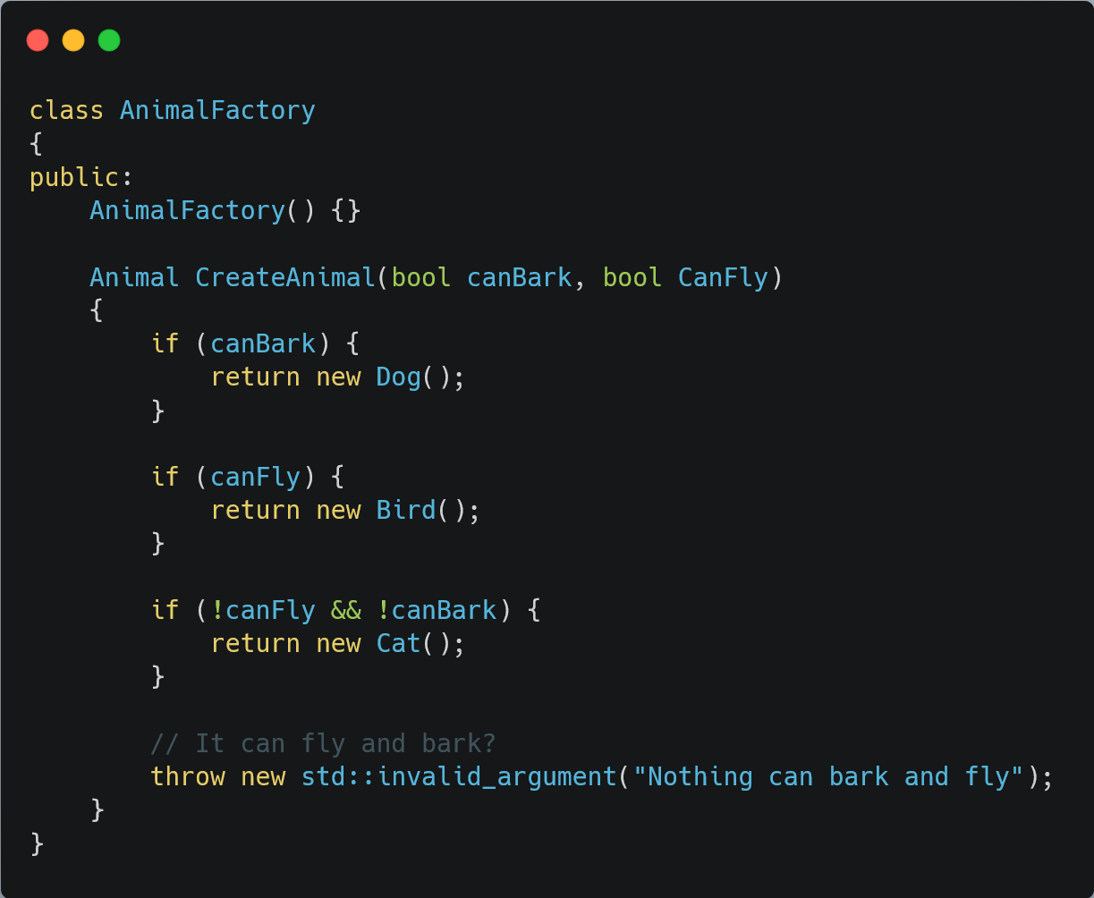
Dynamically creating concretes
Factory pattern
Given an interface such as an Animal, when do I create a Dog?
Maps logic to a set of concrete classes
Abstracts logic away to create an object

Slide 13
Event systems
Raise events when things happen
React to events and run logic based on them
Popular event architectures:
“Reactive” (subscribe to events)
CQRS (command-query responsibility segregation)

Slide 14
Back to the patients CLI

Slide 15
Thanks for coming! Questions?

